Slide 1


Compressed EWK study(ISRC1N2)
Department of Physics, Shandong University
Chengxin Liao
liaocx@ihep.ac.cn
Mar, Wed 12, 2025

Slide 2
Tasklist
Summary for the SR in C1N2ISR
BSc thesis: https://www.overleaf.com/project/674e7119837a2580151a0868
ABCD method note/bkg estimation: any note or paper I can follow/ref?
Chengxin Liao
IHEP SUSY Meeting

Slide 3
Outline
1. Hyperparameters optimization 1.1 LH channel 1.2 HH channel
2. Performance of Model 2.1 LH channel 2.2 HH channel 2.3 SR definition 3. Backup
1
Chengxin Liao
IHEP SUSY Meeting

Slide 4
Hyperparameters Optimization

Slide 5
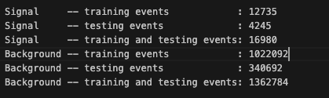
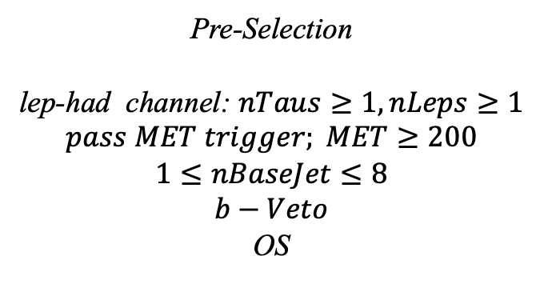
Hyperparameters optimization(LH)
Input(LH-Channel):
Sample:
Sig: ISRC1N2(mass_C1 = 100GeV, mass_N2 = 70GeV)->21225 entries
Bkg: 1703476 entries
All input data(C1N2_100_70 and Bkg) already passed pre-selection
Pre-Selection
lep-had channel: $nTaus≥1, nLeps≥1$
$$pass MET trigger; MET≥200$$
$$1≤nBaseJet≤8$$
$$b−Veto$$
OS
Strategy:
method: BDTG Separate sig(bkg) into five folders, one for test, the other three for train, and last one for validation set,then traverse all possibilities.
1
Chengxin Liao
IHEP SUSY Meeting

Slide 6
Hyperparameters optimization(LH)
Variables(30):
Obj kinematics nBase_Jet mt_lep e_lep(energy of tau2)
Angular correlations dPhitt dRtt dRt1x
dPhiMin_xj
dPhiMax_tj
Event kinematics
Mll(Invariant Mass of tau1 and tau2) METsig MT2_50 Mwh(Invariant Mass of tau1 and MET) Mwl(Invariant Mass of tau2 and MET) MCT(Transverse Mass Squared) Proj_j(Projection of pt jet on zeta) Proj_tt(Projection of tau1+tau2 on zeta) mtx_tau
Mtx_lep
ht_tau mt_quad_sum mt_sum frac_MET_tau1 frac_MET_tau2 frac_MET_tt
frac_MET_sqrtHT_40
frac_jet_tau1
frac_jet_tau2 frac_jet_tt
MT_taumin pt_Vframe
High importance at shiyi’s feature
Note:
zeta is bisector direction of tau1 and tau2[PhyUtils::bisector(tau1, tau2)]
2
Chengxin Liao
IHEP SUSY Meeting

Slide 7
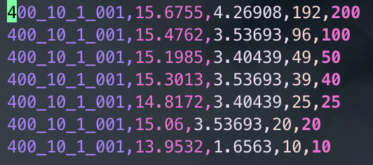
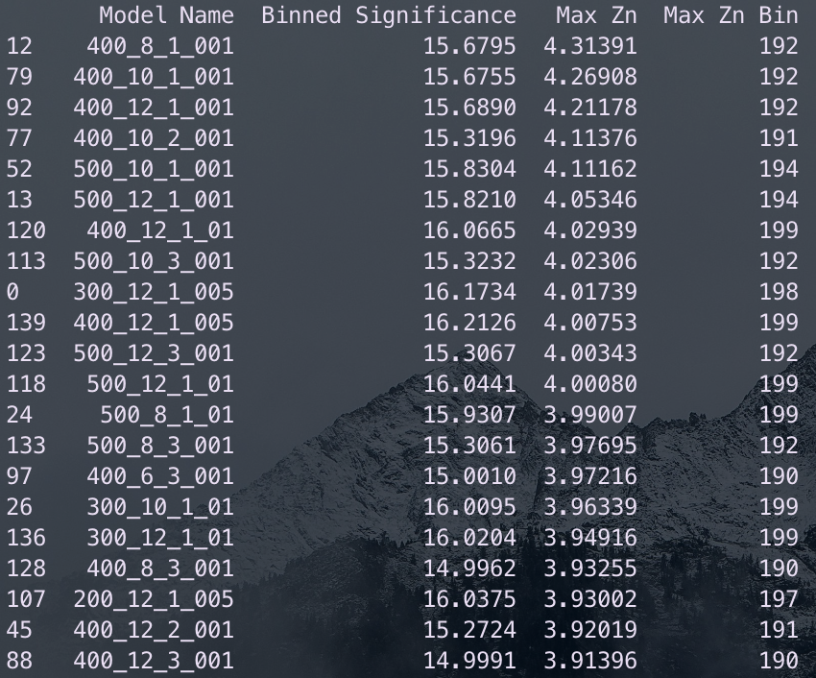
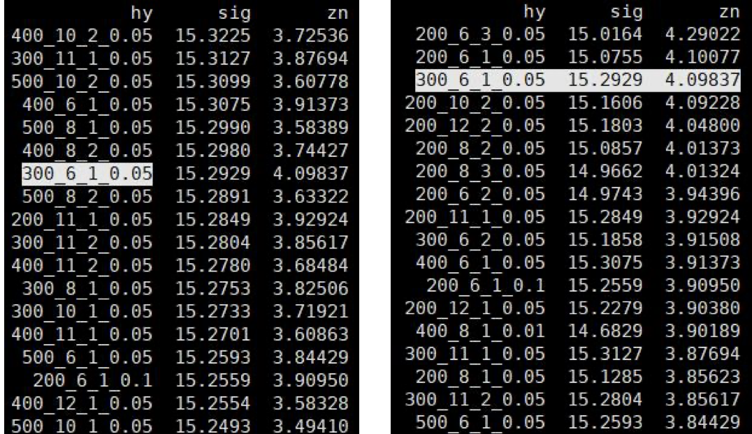
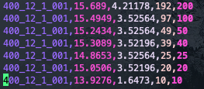
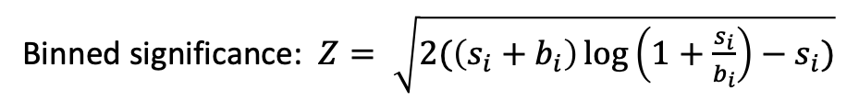
Hyperparameters optimization(LH)
Grid Search:
Binned significance: $Z= \sqrt{2(\left(s_{i}+b_{i}\right)\log\left(1+\frac{s_{i}}{b_{i}}\right)−s_{i})}$
Ntrees: 200, 300, 400, 500
Max Depth: 6, 8, 10, 12 MinNodeSize: 1%, 2%, 3% Learning Rate: 0.01, 0.05, 0.1
Show top Zn
Shiyi’s result of LH channel
Top Sig
Top Zn
3
Chengxin Liao
IHEP SUSY Meeting

Slide 8
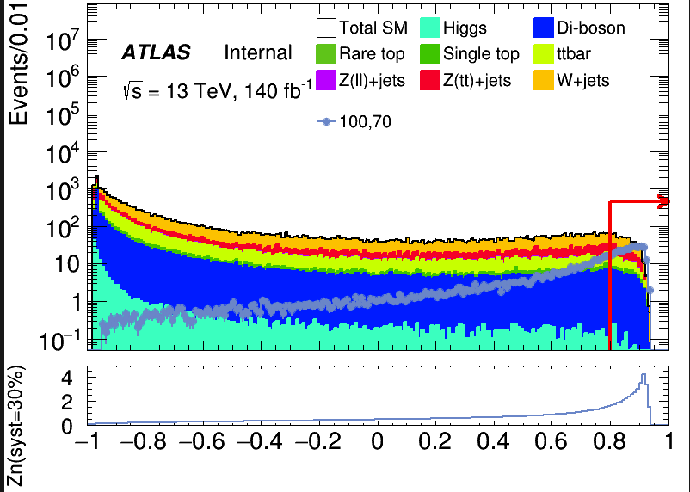
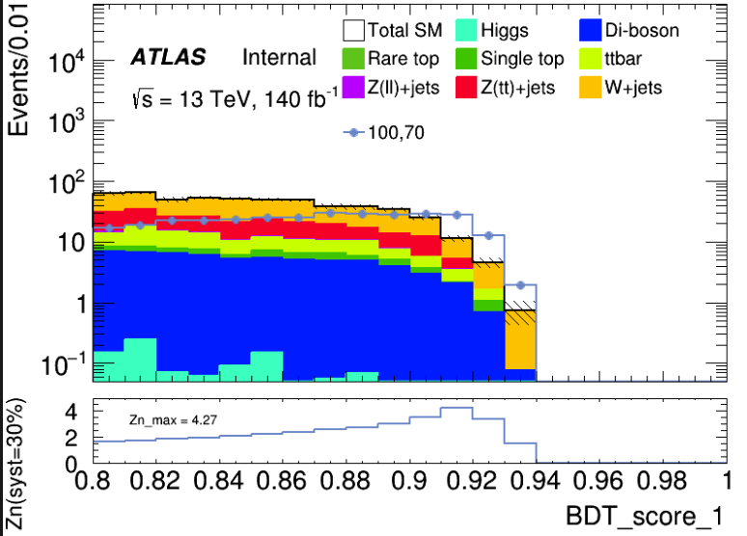

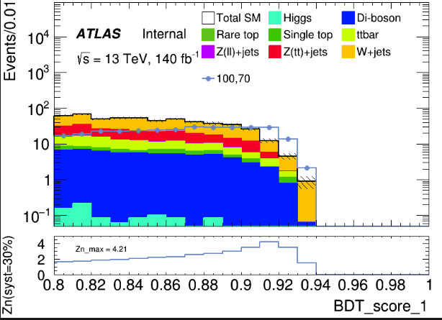
Hyperparameters optimization(LH)
hyper parameter: NTrees=400, learning rate=0.01, max depth=10, MinNodeSize=1%(default)
Cut at BDT_score = 0.8
hyper parameter: NTrees=400, learning rate=0.01, max depth=12, MinNodeSize=1%(default)
4
Chengxin Liao
IHEP SUSY Meeting

Slide 9
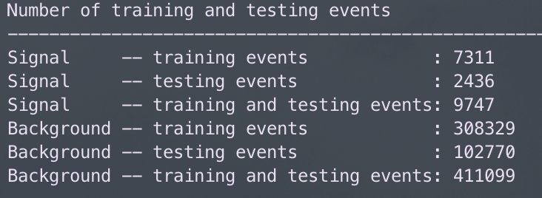
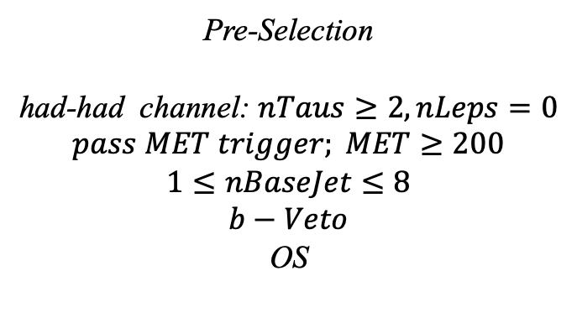
Hyperparameters optimization(HH)
Input(HH-Channel):
Sample:
Sig: ISRC1N2(mass_C1 = 100GeV, mass_N2 = 70GeV)->12180 entries
Bkg: 513850 entries
All input data(C1N2_100_70 and Bkg) already passed pre-selection
Pre-Selection
had-had channel: $nTaus≥2, nLeps=0$
$$pass MET trigger; MET≥200$$
$$1≤nBaseJet≤8$$
$$b−Veto$$
OS
Strategy:
method: BDTG Separate sig(bkg) into five folders, one for test, the other three for train, and last one for validation set,then traverse all possibilities.
5
Chengxin Liao
IHEP SUSY Meeting

Slide 10
Hyperparameters optimization(HH)
Variables(26):
Obj kinematics Pt_tt
Angular correlations dPhit1x dEtatt dPhiMax_xt
dPhiztt
dPhitt
dPhizxe
dPhiMin_xt
dPhit2x
dPhiMin_tj1
dRt2x
dRMax_xt
dRMin_tj
dRtt
sum_cos_dphi
Event kinematics
Mll(Invariant Mass of tau1 and tau2) MIA MT2_150 MET_Tau Proj_tt MstauA MCT frac_MET_tt frac_MET_tau1
frac_MET_MeffInc_40
frac_MET_Meff
These vars are selected based on the importance
6
Chengxin Liao
IHEP SUSY Meeting

Slide 11
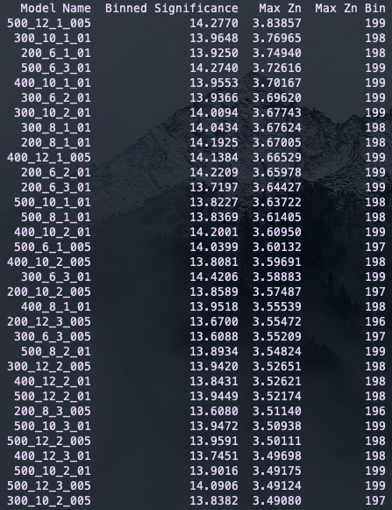
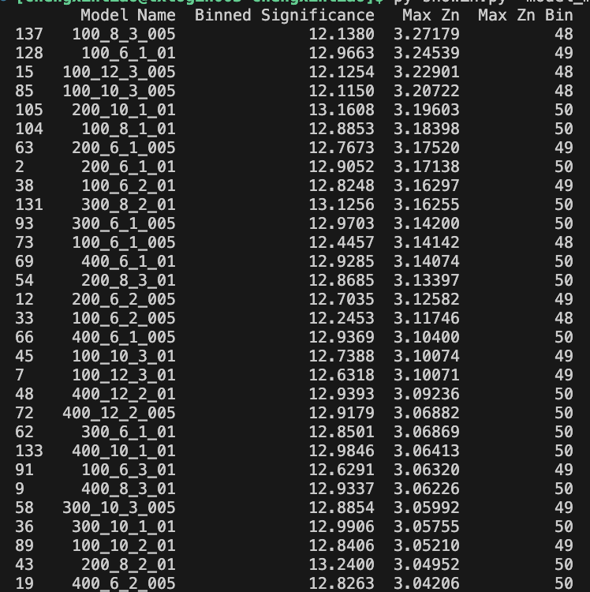
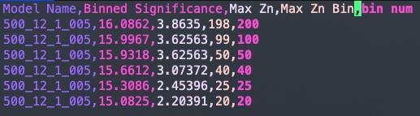
Hyperparameters optimization(HH)
Grid Search:
Binned significance: $Z= \sqrt{2(\left(s_{i}+b_{i}\right)\log\left(1+\frac{s_{i}}{b_{i}}\right)−s_{i})}$
Ntrees: 200, 300, 400, 500
Max Depth: 6, 8, 10, 12 MinNodeSize: 1%, 2%, 3% Learning Rate: 0.01, 0.05, 0.1
Show top Zn
Compared with form result, there has a significant improvement in Zn
Rebin result
7
Chengxin Liao
IHEP SUSY Meeting

Slide 12
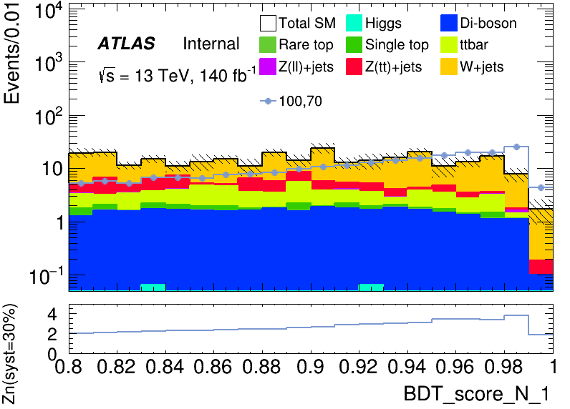
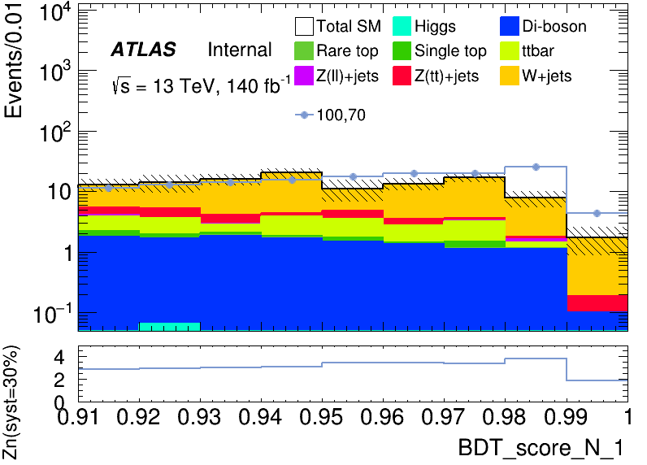
Hyperparameters optimization(HH)
hyper parameter: NTrees=500, learning rate=0.05, max depth=12, MinNodeSize=1%(default)
Apply a rough cut at 0.80 to check the distribution
It has a wider peak than LH signal region
Precise cut at 0.91 to define signal region
Rebin to: [0.91, 0.94, 0.97, 1.00]
8
Chengxin Liao
IHEP SUSY Meeting

Slide 13
Performance of Model

Slide 14
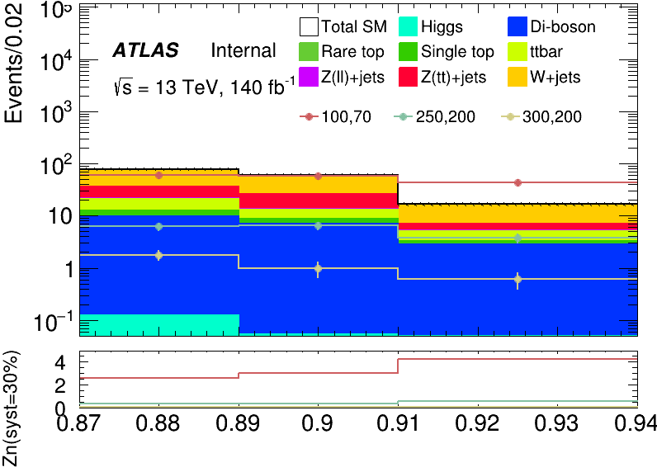
Performance of Model(LH)
hyper parameter: NTrees=400, learning rate=0.01, max depth=10, MinNodeSize=1%(default)
Apply BDT score cut at 0.87
Root of square sum of Zn of each bin: 5.8479
Rebin to: [0.87, 0.89, 0.91, 0.94]
bin | max Zn | C1N2ISR (100,70) | bkg | Higgs | OtherTop | SingleTop | TopPair | VV | Wjets | Zlljets | Zttjets
(0.87-0.89) | 2.59868 | 59.238+-1.484 | 76.648+- 5.530(7.21%) | 0.126+-0.034 | 0.033+-0.021 | 2.619+-0.548 | 8.311+-1.141 | 9.569+-0.520 | 39.971+-5.074 | 0.760+-0.130 | 15.259+-1.718
(0.89-0.91) | 3.03656 | 57.663+-1.447 | 59.803+- 3.946(6.59%) | 0.053+-0.020 | 0.078+-0.030 | 1.761+-0.420 | 4.401+-0.823 | 6.851+-0.399 | 33.586+-3.367 | 0.453+-0.128 | 12.620+-1.792
(0.91-0.94) | 4.26908 | 42.715+-1.251 | 16.632+- 1.683(10.11%) | 0.005+-0.004 | 0.006+-0.004 | 0.450+-0.202 | 1.819+-0.532 | 2.858+-0.249 | 9.733+-1.536 | 0.039+-0.020 | 1.722+-0.298
9
Chengxin Liao
IHEP SUSY Meeting

Slide 15
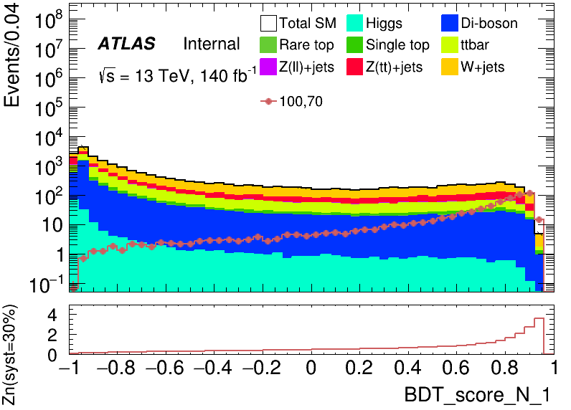
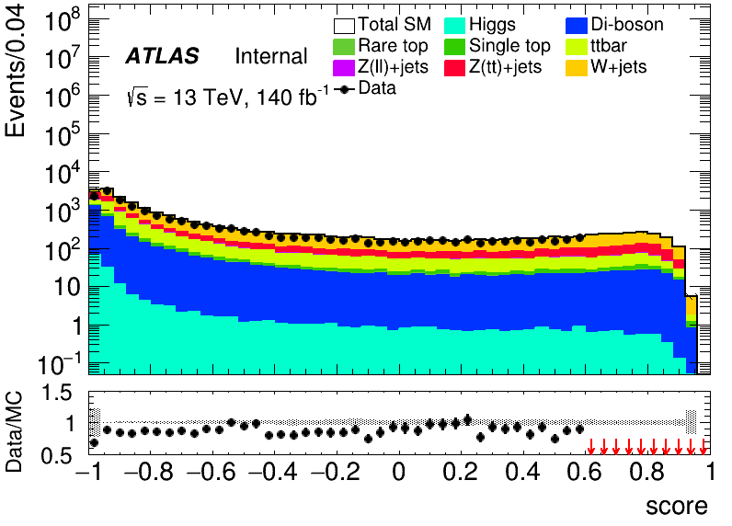
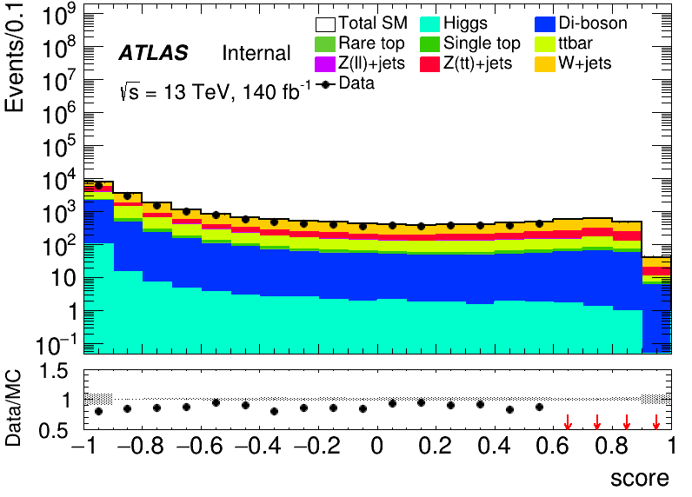
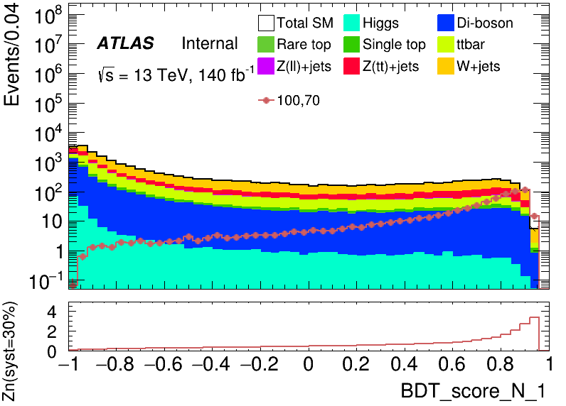
Performance of Model(LH)
hyper parameter: NTrees=400, learning rate=0.01, max depth=10, MinNodeSize=1%(default)
50 bins
20 bins
BDT score distribution of Validation set
BDT score distribution of test set and data (Blind with events with score > 0.6)
BDT score distribution of Test set
10
Chengxin Liao
IHEP SUSY Meeting

Slide 16
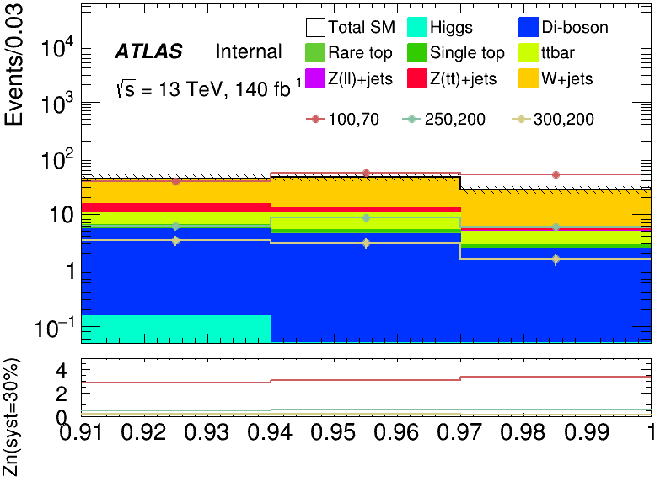
Performance of Model(HH)
hyper parameter: NTrees=500, learning rate=0.05, max depth=12, MinNodeSize=1%(default)
Root of quadratic sum of Zn = 5.3163
Rebin to: [0.91, 0.94, 0.97, 1.00]
bin | Zn | C1N2ISR (100,70) | bkg | SingleTop | Zttjets | Wjets | OtherTop | VV | Zlljets | TopPair | Higgs
bin1 | 2.8678146 | 38.472+-1.192 | 42.986+-6.490(15.09%) | 0.958+-0.303 | 4.090+-0.675 | 28.198+-6.388 | 0.026+-0.020 | 5.144+-0.289 | 0.265+-0.185 | 4.156+-0.802 | 0.150+-0.041
bin2 | 3.1193828 | 53.206+-1.399 | 44.788+-6.647(14.86%) | 0.473+-0.239 | 2.435+-0.612 | 32.118+-6.547 | 0.033+-0.022 | 4.512+-0.303 | 0.040+-0.026 | 5.158+-0.888 | 0.019+-0.014
bin3 | 3.4088980 | 49.550+-1.350 | 26.640+-3.905(14.65%) | 0.348+-0.184 | 0.600+-0.129 | 21.041+-3.850 | 0.034+-0.017 | 2.363+-0.189 | 0.196+-0.123 | 2.050+-0.570 | 0.007+-0.007
11
Chengxin Liao
IHEP SUSY Meeting

Slide 17
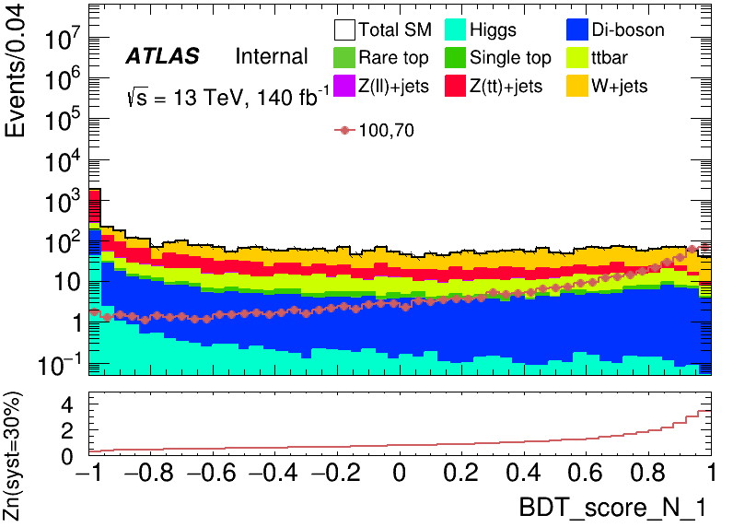
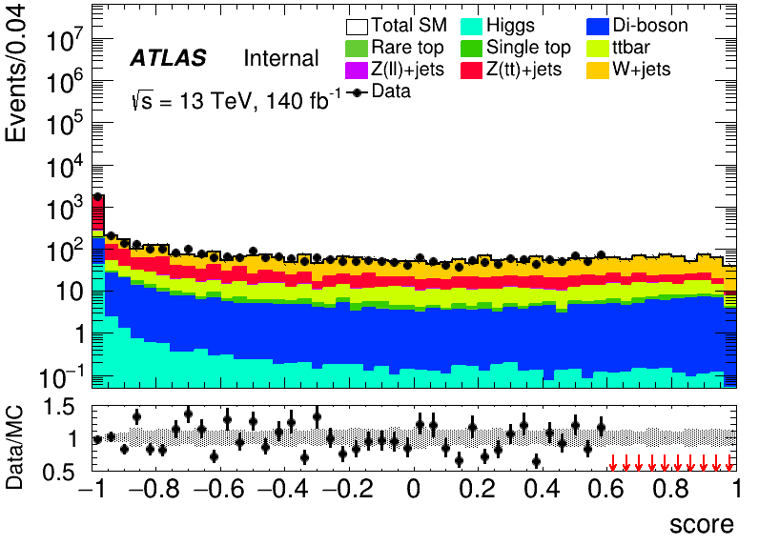
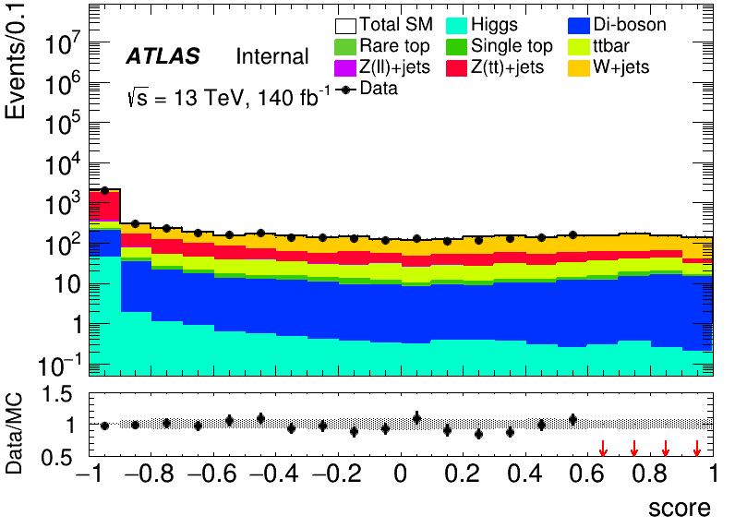
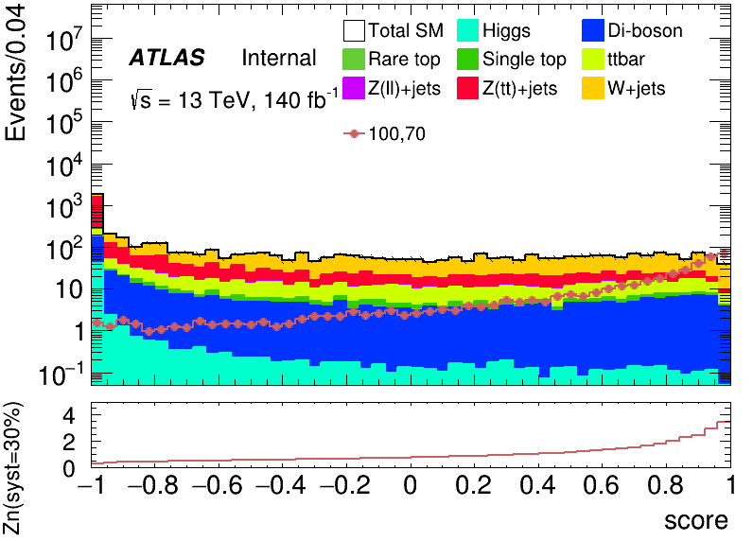
Performance of Model(HH)
hyper parameter: NTrees=500, learning rate=0.05, max depth=12, MinNodeSize=1%(default)
50 bins
20 bins
BDT score distribution of Validation set
BDT score distribution of test set and data (Blind with events with score > 0.6)
BDT score distribution of Test set
12
Chengxin Liao
IHEP SUSY Meeting

Slide 18
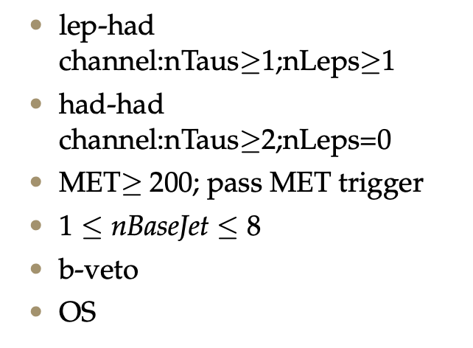
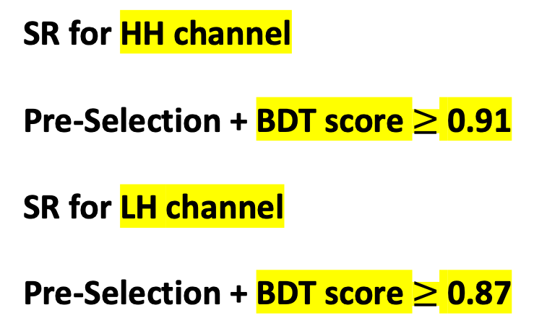
SR definition
Pre-Selection
SR for HH channel Pre-Selection + BDT score $≥$ 0.91 SR for LH channel Pre-Selection + BDT score $≥$ 0.87
13
Chengxin Liao
IHEP SUSY Meeting

Slide 19
TODO
1. bkg estimation and define VR and CR 2. significance map
13
Chengxin Liao
IHEP SUSY Meeting

Slide 20
Backup

Slide 21
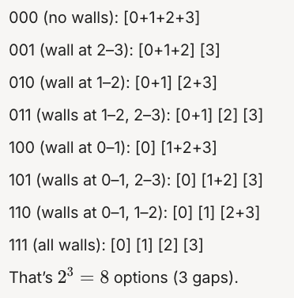
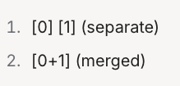
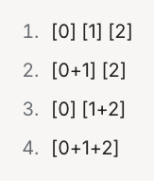
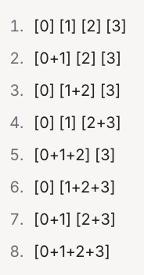
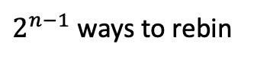
BackUp
An Interesting Method to Rebin
Example in 4 bins
It can be proved that there are $2^{n−1}$ ways to rebin if histgram have n bins except 2 bins
2 bins
Oredered the method and trun into binary number
Based on Mathmatical Induction
3 bins
$2^{n−1}$ ways to rebin
4 bins
8
Chengxin Liao
IHEP SUSY Meeting

Slide 22
BackUp
Feature_distribution
8
Chengxin Liao
IHEP SUSY Meeting

